Slide 1



Department of Computer Science and Engineering
Eye Power Prediction Using Deep Learning
DEEPAK N / 211420104053
GODWIN BENJAMIN DASS A S / 211420104079
DHINAKARAN R / 211420104066
Sustainable Development GOALS:
3 - Good Health
7 - Affordable and Clean Energy
10 - Decent Work and Economic Growth
S. PREENA JACINTH SALOM
ASSISTANT PROFESSOR
Dr .N. PUGHAZENDHI
PROFESSOR

Slide 2
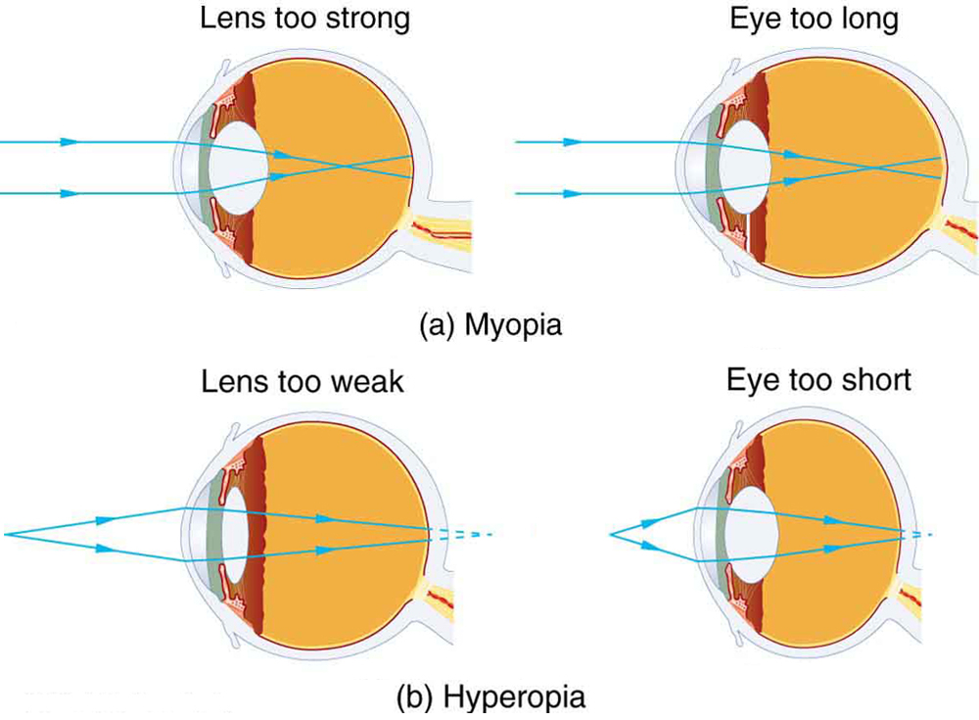
Introduction
Refractive Errors:
Refractive errors are a type of visual problem that reduces our visibility and makes it hard to see. The image is formed at the retina of the eye for a normal eye, which is real and inverted. If the image is formed before or beyond the retina then it is called a refractive error.

Slide 3
Objective of the Project
The main objective of this project is to create a software system that can be used to calculate eye power and predict the type of eye disease that the user may have (i.e.,) refractive errors, without using any hardware measuring meters to eye power. Hardware devices are very hard to transport and handle, we intent to create a software which is portable and user friendly.

Slide 4
Literature Survey
YEAR | TITLE AND JOURNAL | AUTHOR | DESCRIPTION | ADVANTAGES | DISADVANTAGES
2005 | Myopia and associated pathological complications. Ophthalmic and Physiological Optics | Saw, S. M., Gazzard, G., Shih-Yen, E. C. and Chua, W. H. | Reviews the epidemiology of myopia, its associated risk factors, and the potential pathological complications that may arise, such as retinal detachment, glaucoma, and myopic maculopathy. | Gives a clear explanation of myopia and its complications | Only talks about myopia and does not give any research on other refractive errors
2018 | The epidemics of myopia: Aetiology and prevention. Progress in Retinal and Eye Research | Morgan, I. G., French, A. N., Ashby, R. S., Guo, X., Ding, X., He, M., and Rose, K. A. | Analysis and gives systematic review evaluate the relationship between time spent in outdoor activities and the prevention and control of myopia. | Analysis of the causes of myopia | It doesn’t consider the causes of other refractive errors

Slide 5
Problem Statement
To develop a eco-friendly and easy to handle software systems that can be used to predict the human eye power and refractive errors.

Slide 6
Proposed System
An AI system that uses the phone selfie camera to predict the power of the eye and predict what refractive errors the user may have such as myopia, hyperopia, or normal. It makes

Slide 7
Module
User module.
Server module
Feature extraction module
Distance estimation module
Power calculation module

Slide 8
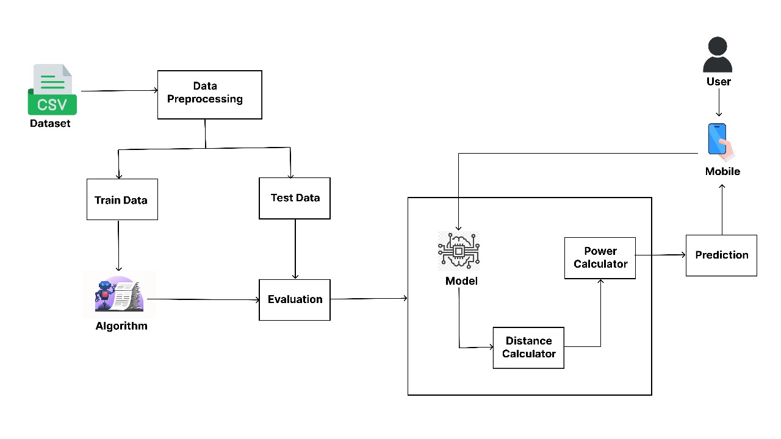
Architecture / Methodology used

Slide 9
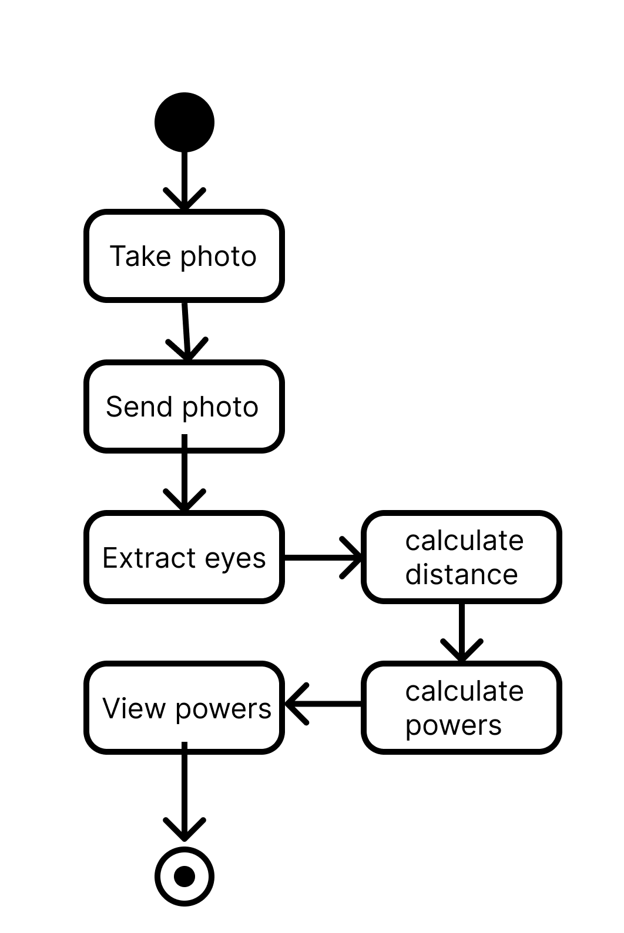
Control Flow of the System

Slide 10

Module Description
USER MODULE
The user adjusts the size of the font so that it is comfortable to read, and then the user is asked to take a photo while holding it at a comfortable distance while seeing the text with the left eye, or right eye and with both eyes.
After taking the photos an HTTPS request is sent to the server, and the images are used for prediction after the prediction a response is obtained in JSON format.

Slide 11
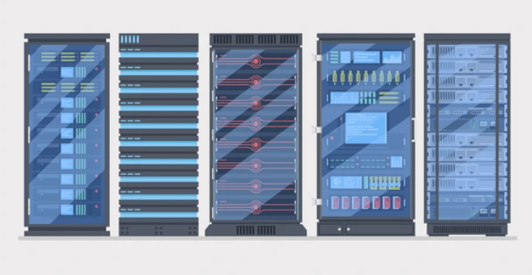
Module Description
SERVER MODULE
The system is hosted on a server so that it can be integrated with the mobile app.
The image and the font size are sent to the deployed model with the help of the REST APIs with the POST method, and then the request is added to the queue when the server receives the image and the font size it proceeds to flow.

Slide 12
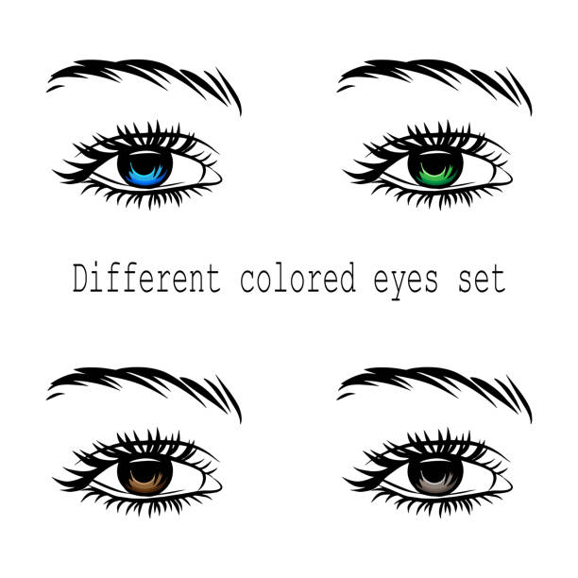
Module Description
FEATURE EXTRACTION MODULE
Its primary function is to identify and isolate the eyes within an image of a person, serving as the foundational step for subsequent analysis.
By isolating and capturing the unique characteristics of the eyes, such as pupil dilation or movement patterns, the model provides essential insights into the subject's physiological state.

Slide 13
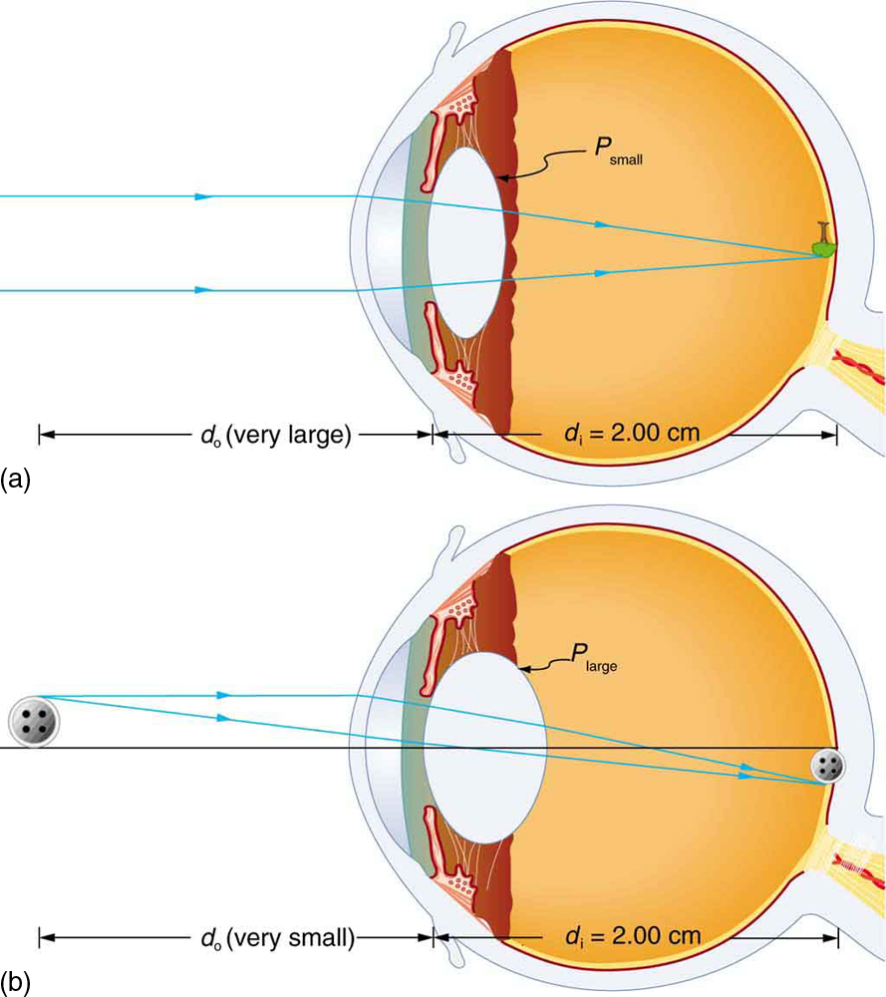
Module Description
DISTANCE ESTIMATION MODULE
Let’s say we have a marker or object with a known width W. We then place this marker some distance D from our camera. We take a picture of our object using our camera and then measure the apparent width in pixels P. This allows us to derive the perceived focal length F of our camera
F = (P * D) / W
By rearranging the formula, we can find the distance of the object from the camera:
D’ = (W * F) / P

Slide 14
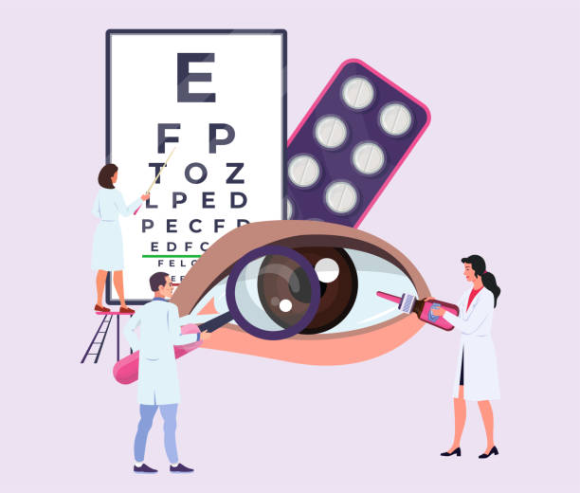
Module Description
POWER CALCULATION MODULE
The power of the lens is calculated by measuring the object's distance from the eye and considering the average distance of image formation inside our eyes.
P = 1/d_{i} + 1/d_{o}
Where,
d_{i} - Image formation distance inside the eye
d_{o} - Object distance from the eye

Slide 15
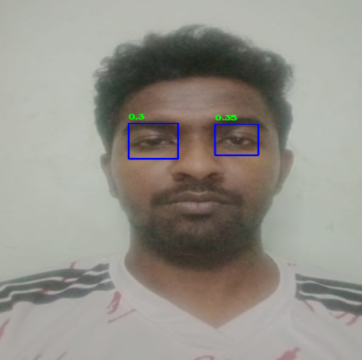
Testing /Performance Evaluation / Results
Checking if the model detects eyes accurately

Slide 16
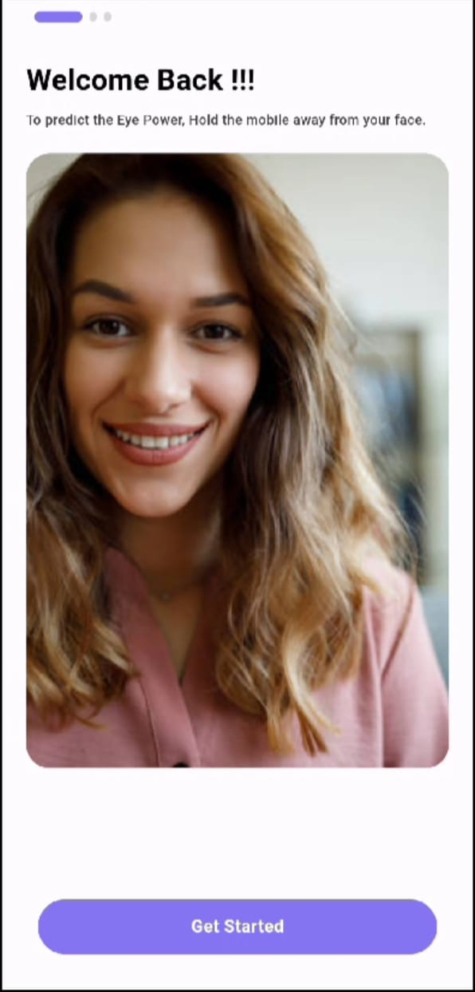
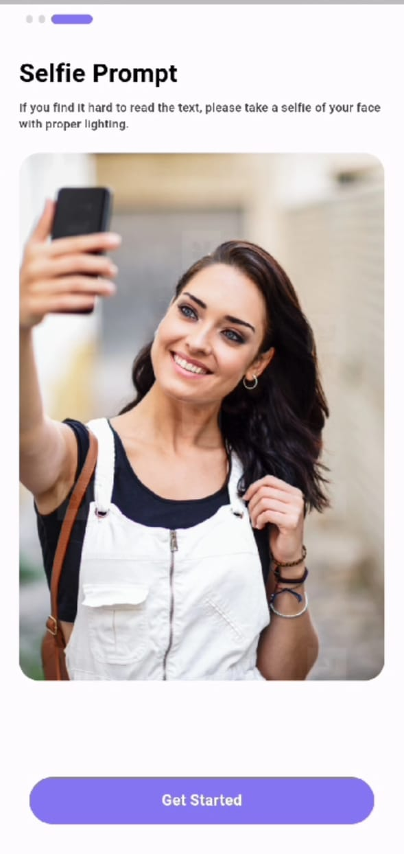
Screen Shots

Slide 17
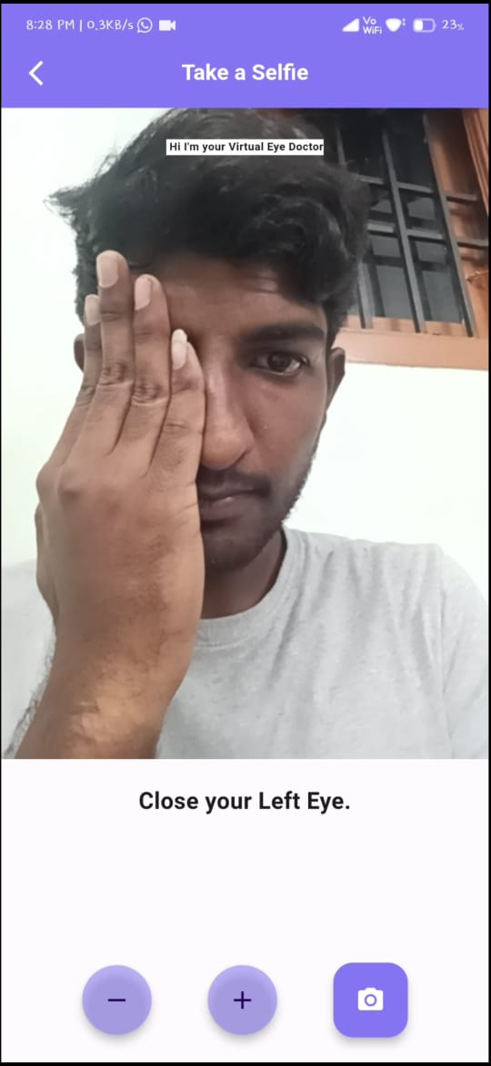
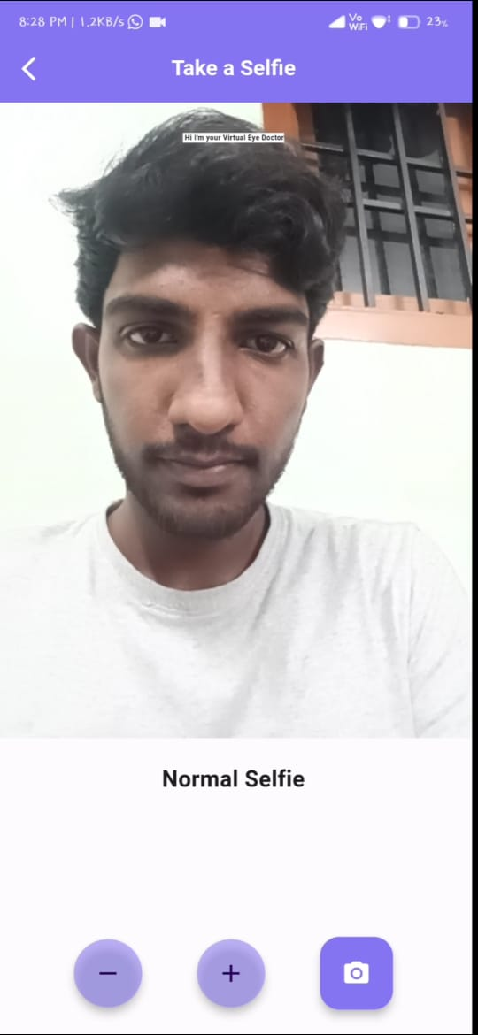
Screen Shots

Slide 18
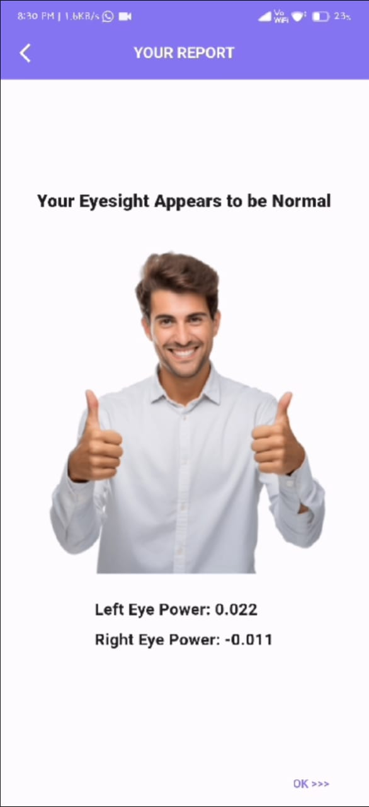
Screen Shots

Slide 19
Conclusion / Feature Enhancement
Our deep learning-based software solution, developed using OpenCV, represents a pioneering step towards democratizing access to accurate and efficient refractive error diagnosis. By harnessing the power of artificial intelligence, we aspire to mitigate the burden on healthcare systems and empower individuals to safeguard their ocular health in an increasingly digital world.

